Slide 1
Name of the Student
Professor
Course
Date

Slide 2
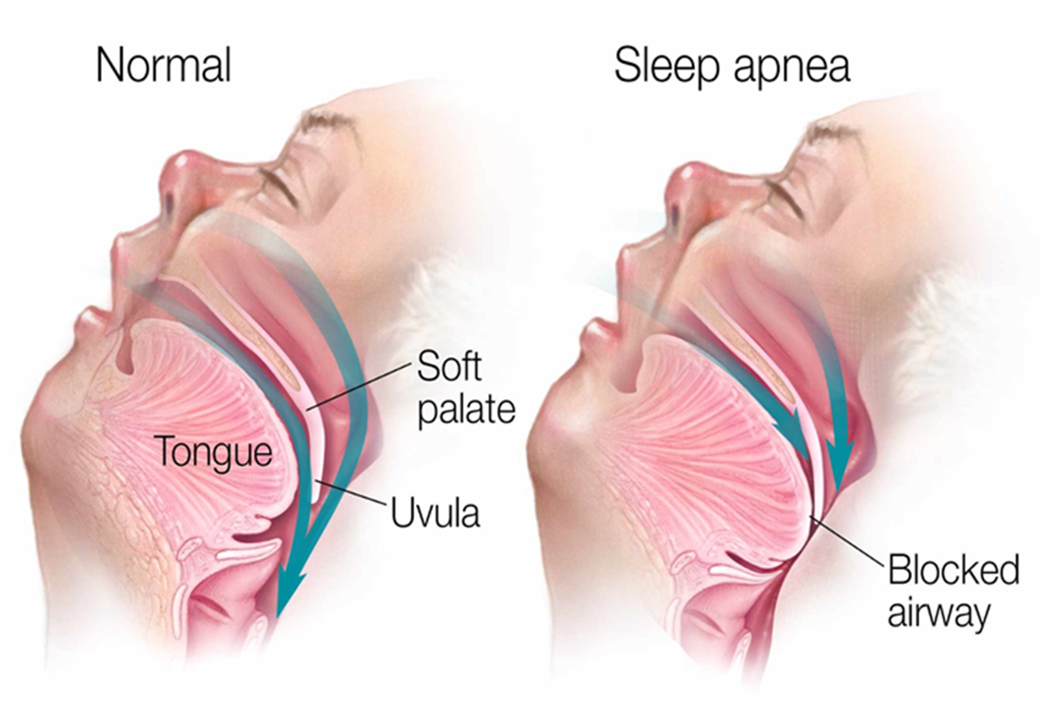
Sleep Apnea
Sleep Apnea is a severe sleeping disorder that is characterized by the interruption of breathing when a person is at sleep. The breathing is stopped by blockage of the airway.
The breathing usually stops for a few seconds and it occurs repetitively.
There are three types of sleep apnea namely obstructive sleep apnea, central sleep apnea, and complex sleep apnea syndrome
(Veasy & Rosen, 2019).
Notes:
Sleep apnea is a sleep disorder that is characterized by repetitive failure of the breathing system.

Slide 3
Symptoms of Sleep Apnea
Snoring
Gasping for air when a person is at sleep
Morning headache
Insomnia
Hypersomnia
Irritability
Difficulty in paying attention when a person is awake.
(Veasey & Rosen, 2019)
Notes:
Snoring- a person snores due to nasal congestion, which causes difficulty in breathing.
Insomnia- a person experiences difficulty in sleeping
The morning headache occurs because of reduced oxygen flow in the brain when a person is at sleep
Hypersomnia- A person experiences excessive sleep during daytime
Irritability- a person experiences irritability in the breathing system.

Slide 4
Obstructive sleep Apnea
Obstructive sleep apnea (OSA)- is characterized by involuntarily and brief stopping of breathing when a person is at sleep.
The breathing stops due to partial or complete obstruction of the upper airway when a person is at sleep. Each cycles of obstruction is known as apnea
The blockage of upper airways is a result of the collapsing of the pharyngeal airway.
A high frequency of apneas when a person is sleeping interferes with the sleep and blood oxygenation.
Loud snoring is a common symptom of obstructive sleep apnea.
(Arnold et al., 2017)
Notes:
Involuntary means that there is no conscious control in the collapsing of the muscles. The pharyngeal airway collapses involuntary thus, blocking the airflow.

Slide 5
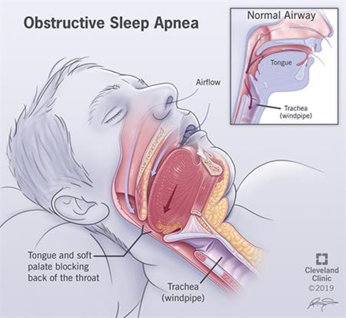
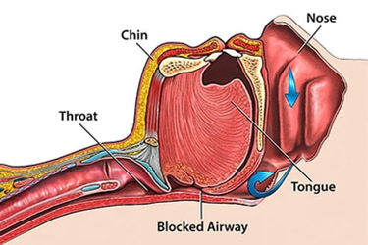
Obstructive sleep Apnea
The below images showcase how sleep apnea blocks the airways when a person it at sleep.
(Leger & stepnowsky, 2020)
Notes:
It is evident that obstructive sleep apnea occurs when muscles that control soft tissues in the throat such as palate and tongue tissues collapse temporarily.

Slide 6
Effect of obstructive sleep apnea on the muscular system
Repetitive respiratory exertion on the obstructed airway tends to be deleterious on the respiratory muscles (Dilator muscles such as palatal and tensor palatini muscles) .
An obstructed airway is prone to experience respiratory effort.
Obstructive sleep apnea leads to respiratory muscle pain, which makes it hard to sleep.
Obstructive sleep apnea leads to fatigue of the respiratory muscles because of repetitive muscles exertion, caused by the blockage of the airways.
Respiratory muscles suffer from fatigue and decline of strength due to the repetitive respiratory exertion caused by the blocked airways.
(Jansen et al., 2018)
Notes:
Obstructive sleep apnea tends to have a huge impact on the muscular system. The obstruction causes respiratory load and repetitive respiratory exertion, which injures the respiratory muscles.
Respiratory muscle pain contributes to insomnia.
A fatigued and weak respiratory muscle is unlikely to perform efficiently and effectively.

Slide 7
Obstructive sleep apnea creates changes in the skeletal muscle structure
It causes the skeletal muscle structure to change in fiber size and type.
The change occurs to patients with obstructive sleep apnea related chronic obstructive pulmonary disease, chronic heart failure, and peripheral arterial disease.
These conditions are usually as a result of insufficient oxygen saturation in the blood.
Sufficient oxygen saturation is important for converting nutrients into the energy necessary for the body.
Skeletal muscles require the necessary nutrients to function properly and quickly
When the skeletal muscle structure is deprived the necessary nutrients due to lack of oxygen saturation in the blood, it is exposed to quick fatigue , weakness, and change of the structure.
(Javaheri et al., 2017)
Notes:
Obstructive sleep apnea leads to insufficient oxygen saturation in the blood. Oxygen is necessary for converting nutrients into energy. Lack of sufficient oxygen saturation means less energy conversion. Skeletal muscle system require energy for appropriate functioning. Lack of sufficient energy alters the functioning and the growth of the skeletal muscles.

Slide 8
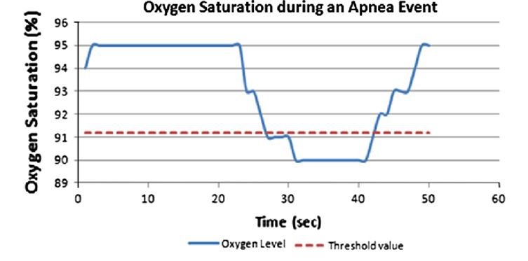
Oxygen desaturation during sleep apnea
The diagram below shows that oxygen saturation falls below the threshold value in each apnea cycle.
(Javaheri et al., 2017)
Notes:
Repeated apnea cycles leads to increase oxygen desaturation in the blood.

Slide 9
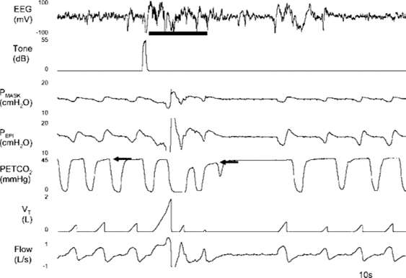
Central Sleep Apnea
Central sleep Apnea- pauses in breathing when a person is sleeping due to lack of respiratory efforts.
Central sleep apnea occurs due to the disruption of the brain signals that enable breathing.
Central sleep apnea is characterized by reduction of oxygen saturation in the blood.
Central Apnea Chest
The above diagram shows the pauses of airflow in the lungs of a person with central sleep apnea.
The above section shows a person with central apnea while the lower section shows a person with the condition (Costanzo et al., 2020).
Notes:
Central apnea occurs when respiratory mechanism that controls respiration is unable to respond to brain signals that controls breathing. The dysfunction leads to apneas, which are characterizes by null breath cycles as indicated in the above image.

Slide 10
Central sleep Apnea effect on Nervous system
With central sleep apnea, the pre-Botzinger complex, which monitors respiration and oxygen levels in the body fails to maintain a continuous respiratory cycle.
This leads to accumulation of excessive quantities of carbon II oxide gas in the body and less of oxygen in the brain cells.
Brain cells require constant oxygen to function appropriately and to live.
Low quantities of oxygen triggers seizures and brain damage.
Also, low quantities of oxygen leads to cognitive impairment and struggle.
(Costanzo et al., 2020)
Notes:
Central sleep apnea reduces the nerve activity. The reason is because the apnea deprives brain cell with oxygen, which is essential for the functioning of brain cells.

Slide 11
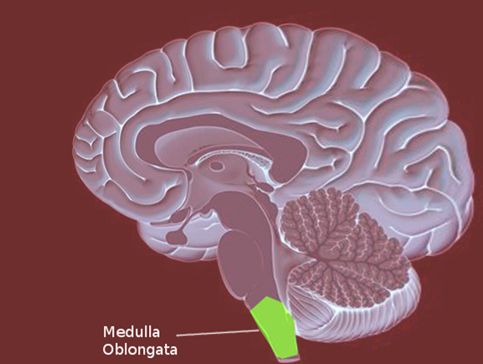
Central Sleep Apnea
To understand how central sleep apnea affects the nervous system, one needs to understand how the brains controls the breathing when a person is asleep.
When asleep, the breathing is mainly controlled by the respiratory control centers that is located in the medulla oblongata of our brain system.
The respiratory control center in the oblongata is referred to as pre-Botzinger complex.
With central sleep apnea, the pre-Botzinger complex center fails to send inhale signals, thus causing a person to miss one or two cycles of breathing.
In the pause of breathing, oxygen circulation drops (hypoxemia) and carbon dioxide levels increase than normal in the body ( hypercapnia).
(Costanzo et al., 2020)
Notes:
The medulla oblongata is located in the lower section of the brain stem. The part that links the brain stem with the spinal chord.
Medulla Oblongata controls involuntary functions such as heart rate and breathing.

Slide 12
Reference
Veasey, S. C., & Rosen, I. M. (2019). Obstructive sleep apnea in adults. New England Journal of Medicine, 380(15), 1442-1449.
Javaheri, Shahrokh, Ferran Barbe, Francisco Campos-Rodriguez, Jerome A. Dempsey, Rami Khayat, Sogol Javaheri, Atul Malhotra et al. "Sleep apnea: types, mechanisms, and clinical cardiovascular consequences." Journal of the American College of Cardiology 69, no. 7 (2017): 841-858.
Leger, D., & Stepnowsky, C. (2020). The economic and societal burden of excessive daytime sleepiness in patients with obstructive sleep apnea. Sleep medicine reviews, 51, 101275.
Costanzo, M. R., Ponikowski, P., Javaheri, S., Augostini, R., Goldberg, L. R., Holcomb, R., ... & remedē System Pivotal Trial Study Group. (2018). Sustained 12 month benefit of phrenic nerve stimulation for central sleep apnea. The American journal of cardiology, 121(11), 1400-1408.

Slide 13
Reference
Arnold, J., Sunilkumar, M., Krishna, V., Yoganand, S. P., Kumar, M. S., & Shanmugapriyan, D. (2017). Obstructive sleep apnea. Journal of pharmacy & bioallied sciences, 9(Suppl 1), S26.
Jansen, C., Hodel, S., Penzel, T., Spott, M., & Krefting, D. (2018). Feature relevance in physiological networks for classification of obstructive sleep apnea. Physiological measurement, 39(12), 124003.

